Slide 1


Title
INTERNSHIP/PROJECT
Presented By:
Student Name:
En. No:
Semester:
Guided By:
Prof. Swati Solanki / Internship Mentor Name
Assistant Professor, Department of Mobile Application and Technologies / Designation of Mentor and Name of Company
M. Sc. IT Data Management & Visual Insight (5 Years Integrated)
Centre for Professional Courses, Gujarat University, Ahmedabad

Slide 2
Abstract

Slide 3
Outline
Introduction
Background Theory
Application of Technology
Literature Survey
Comparative Study
Motivation and Problem Statement
Research Objectives
Proposed Methodology
Conclusion
References

Slide 4
Introduction

Slide 5
Background Theory (cont.)
Figure 1: Figure Name^{[1]}

Slide 6
Background Theory (cont.)

Slide 7
Literature Survey (to be cont.)
Paper 1: | Proposal of Recommender System Based on User Evaluation and Cosmetic Ingredients^{[4]}
Authors: | Rio Iwabuchi, Yoko Nakajima, Hirotoshi Honma, Haruka Aoshima et al.
Publication details: | IEEE, International Conference on Advanced Informatics, Concepts, Theory, and Applications , 2017.
Summary: | Dataset: @cosme and Bihada-Mania Methodology: IF-IPF Authors have defined user categories with similar skin types and for ingredient extraction they have used TF-IPF method. The high IF-IPF value product is recommend to the user. Here, the Invalidated Product Number (IPN) is less than 5%, so this system has certain reliability. Advantage: Reliable due to less number of IPN

Slide 8
Proposed Method:
Extract the product whose product category is skin lotion
From extracted product, extract the product with the number of users who give the specified effect tags > or = threshold value.
Extract the ingredients contained in the skin lotion group
Calculate IF-IPF value and sort ingredients according to that value
Recommend the product containing the top ingredient of IF-IPF value
Figure 3: Flow of proposed system

Slide 9
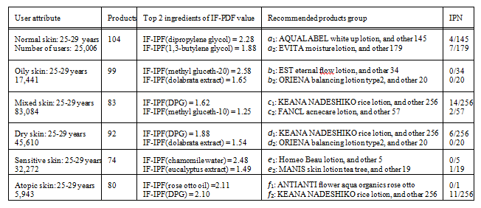
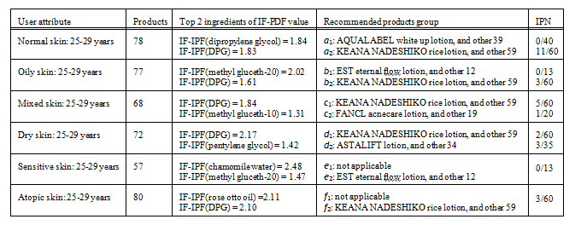
Experiment Result:
Experiment:1
Table 1: High “moisture” effect ingredients and recommended products containing those ingredients^{[4]}
Experiment:2
Table 2 : The top two IF-IPF values and the number of invalidated products of recommendation skin lotion group^{[4]}

Slide 10
Paper 2: | Title^{[5]}
Authors:
Publication details:
Summary:

Slide 11
Comparative Study
No. | Paper Title | Authors | Publication and Publication Year | Method | Limitation/Future work
1. | Proposal of Recommender System Based on User Evaluation and Cosmetic Ingredients [4] | Rio Iwabuchi, Yoko Nakajima et al | IEEE, 2017 | IF-IPF | Could be possible to Acquire highly reliable and effective components.
2. | Paper Title [5]
3. | ……

Slide 12
Motivation and Problem Statement

Slide 13
Research Objectives

Slide 14
Proposed Solution
Tools & Technology:
Tool: Spyder 4
Platform: Python 3.6.4
Libraries: NumPy, Pandas, Keras, and other python libraries which are needed for implementation.
Technique: Deep Learning
: Deep Neural Network Model

Slide 15
Proposed Work

Slide 16
Proposed Methodology

Slide 17
Conclusion

Slide 18
References (cont..)
Kevin Vu, “Deep Learning: Overview and Applications” accessed on 3rd November 2019, https://dzone.com/articles/deep-learning-for-manufacturing-overview-amp-appli.
Qing Chang, “A Deep Learning Approach for MIMO-NOMA Downlink Signal Detection” accessed on 19th August 2019, https://www.mdpi.com/1424-8220/19/11/2526/htm#/.
Jiwon Jiong, “For Your Skin Beauty: Mapping Cosmetic Items with Bokeh”, accessed on 14th August 2019, https://towardsdatascience.com/for-your-skin-beauty-mapping-cosmetic-items-with-bokeh-af7523ca68e5.
Rio Iwabuchi et al, “Proposal of Recommender System Based on User Evaluation and Cosmetic Ingredients”, International Conference on Advanced Informatics, Concepts, Theory and Applications, IEEE 2017, 978-1-5386-3001-3.
Yuki Matsunami et al, “Tag Recommendation Method for a Cosmetics Review Recommender System”, iiWAS’17, ACM 2017, 166-170.

